Slide 1
Operator and Ingress Controller pipy-operator and ingress-pipy

Slide 2
Pipy Operator
pipy-operator

Slide 3
Architecture of pipy-operator
ProxyProfile CRD
Post to register
ProxyProfile CR YAML
API Server
Pod DeploymentYAML
Post to create Custom Resource Object
Post to create Resource Object
Intercepts the AdmissionRequest, patches and returns mutated AdmissionResponse as needed
Watches and handles custom logic
Controller Manager
Proxy Injection
Webhook

Slide 4
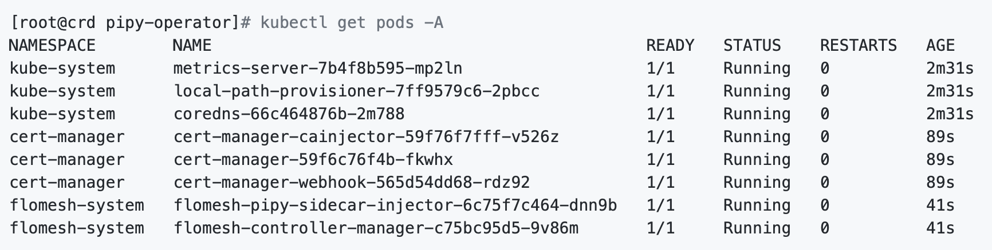
Runtime components of pipy-operator

Slide 5
The ProxyProfile Controller
Custom Controller
API Server
Watches
ProxyProfile
Custom Resource
ProxyProfile controller
Watches
Namespace Resource
ConfigMap Resource
Creates, modifies and deletes

Slide 6
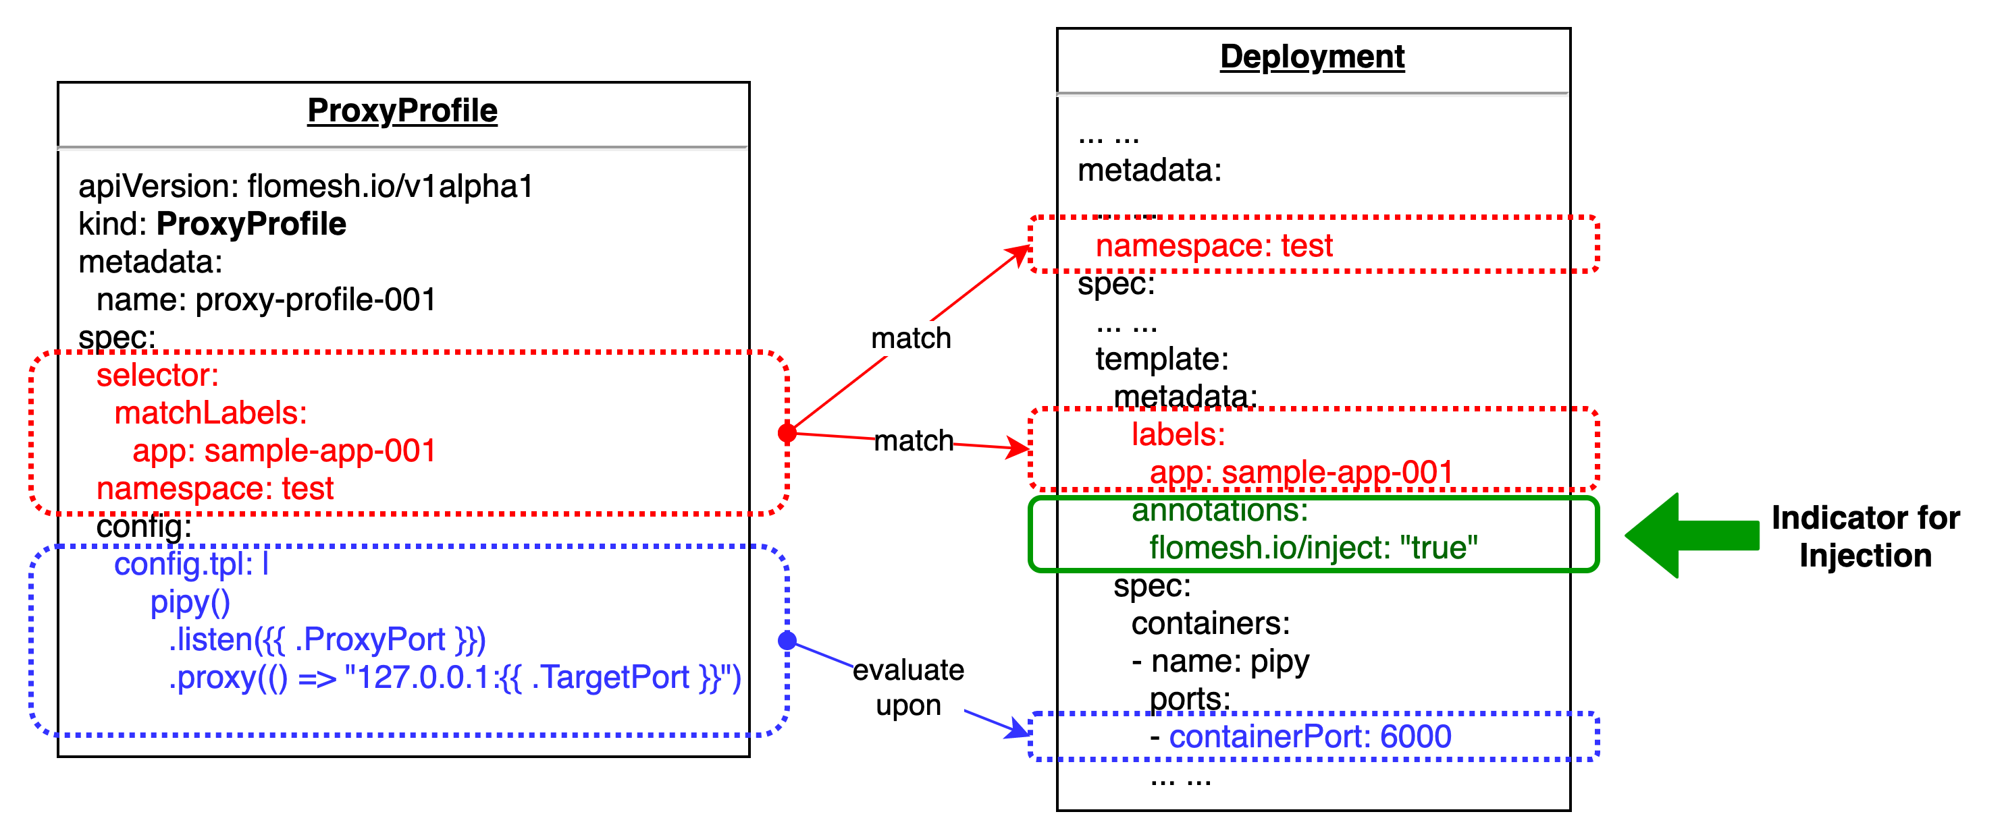
ProxyProfile & Pod Matching

Slide 7
Admission Controller Phases
API Request
API HTTP Handler
Authentication
Authorization
Mutating
Admission
Object Schema
Validation
Validating Admission
Persisted to ETCD
Webhook
Webhook
Webhook

Slide 8
Proxy Injection Webhook
AdmissionRequest
Authentication
Authorization
API Server
Proxy Injection Webhook
Mutating Admission
Mutating Webhooks
Find matched ProxyProfile by labels and namespace
Find ConfigMap, attach the CM volume to sidecar
Create JSON patch
Find matched ConfigMap by selector from ProxyProfile
Pod
proxy-init
AdmissionResponse
Service container
Object Schema
Validation
Sidecar-proxy
/sidecar/config
Validating Admission
Validating Webhooks
etcd
Persisted to etcd

Slide 9

Pod initialization and Sidecar startup
Reads the pod spec, inspects the container port, generates /sidecar/config/config.js upon config.tpl
Starts sidecar with /sidecar/config/config.js
Pod
Init Container
Sidecar Container
Service Container
/config
/sidecar/config
ConfigMap
/sidecar/config
mount
mount
mount
EmptyDir
Mounted as /config, config.tpl and other resources are copied to /sidecar/config
/sidecar/config/config.tpl
/sidecar/config/config.js

Slide 10
Sidecar Traffic Hijacking
The Service Container binds to port 6000 on both network interfaces.
Pod
eth0
Service Container
lo
HTTP(6000)
The Sidecar Proxy sends HTTP requests to Service Container through the pod’s loopback device.
Sidecar Container
HTTP(6010)
The Sidecar Proxy handles HTTP request on port 6010.

Slide 11
Ingress Controller
ingress-pipy

Slide 12
Architecture of ingress-pipy
IngressParameter CRD
Watches Ingress, CRD, Service and Endpoints change, generates Ingress Config Data
Posts to register
IngressParameter CR YAML
API Server
Ingress Config Server
Posts to create Custom Resource Object
Pulls Ingress Config
periodically
Watches and handles custom ingress logic
Serves routing logic by ingress rules and forwards traffic to Endpoints
Controller Manager
Ingress Controller

Slide 13
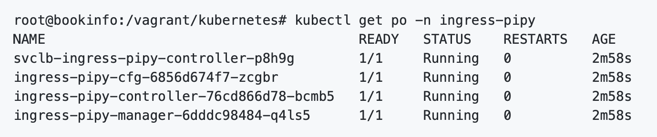
Runtime components of ingress-pipy

Slide 14
Ingress Config Server
Puts Ingress Rule to Endpoints
Mapping into Registry
Ingress Registry
Returns Ingress Rules when client pulls
Ingress
IngressParameter
Watches Ingress And
IngressParameter
Ingress Config Server
Ingress Controller
Pulls Ingress
routing rules
Service
Watches Service
And Endpoints
Endpoints
Service Registry
Looks up Service to
Endpoints Mapping
Puts Service and
Endpoints Mapping
into registry

Slide 15
DEMO
A complete demo with
pipy-operator and ingress-pipy

Slide 16
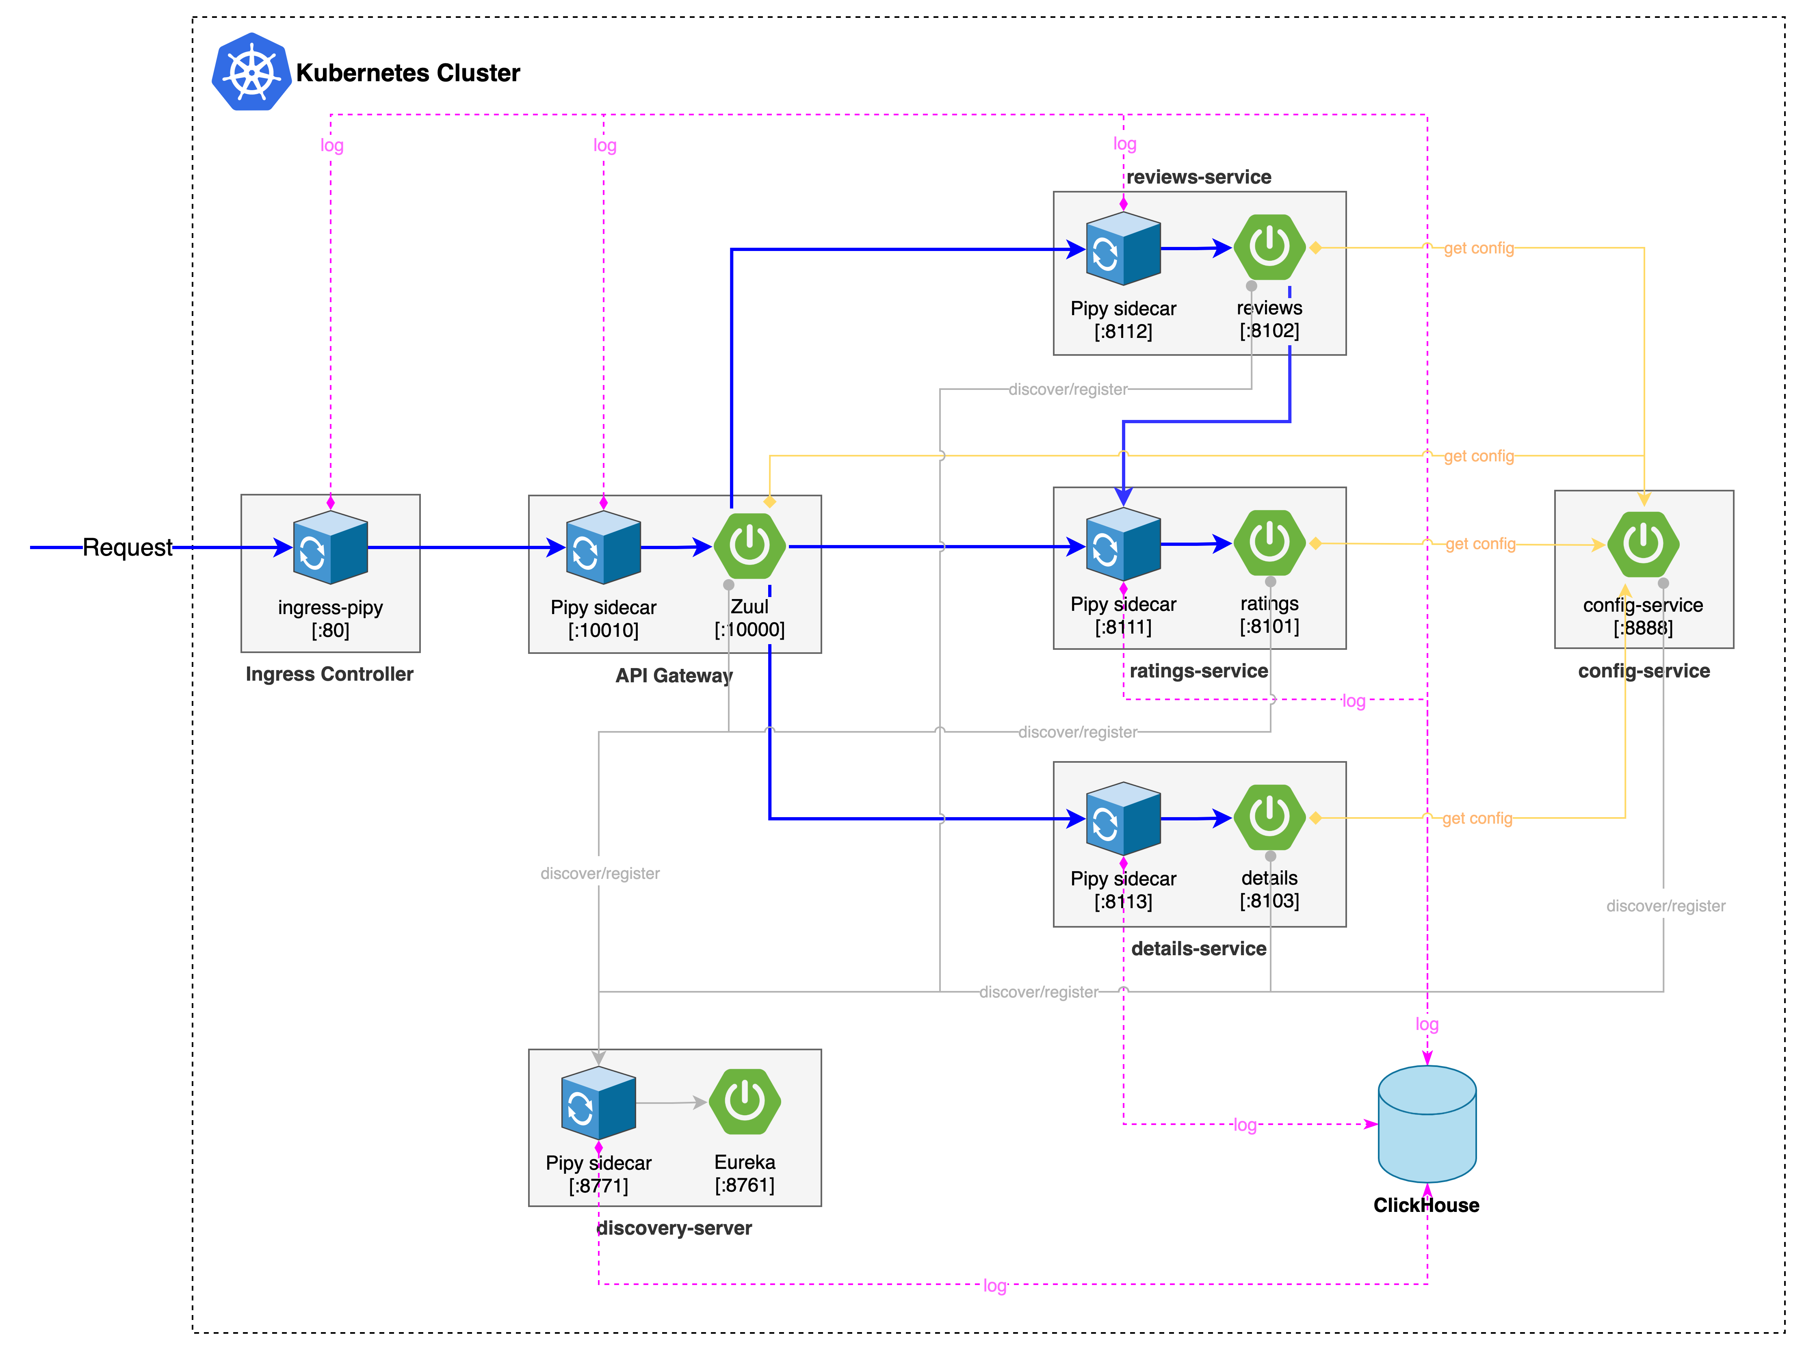
Topology of BookInfo Demo
https://github.com/flomesh-io/flomesh-bookinfo-demo

Slide 17
Deploy Steps
Install cert-manager
Install ingress-pipy
Install BookInfo Demo
Install pipy-operator

Slide 18
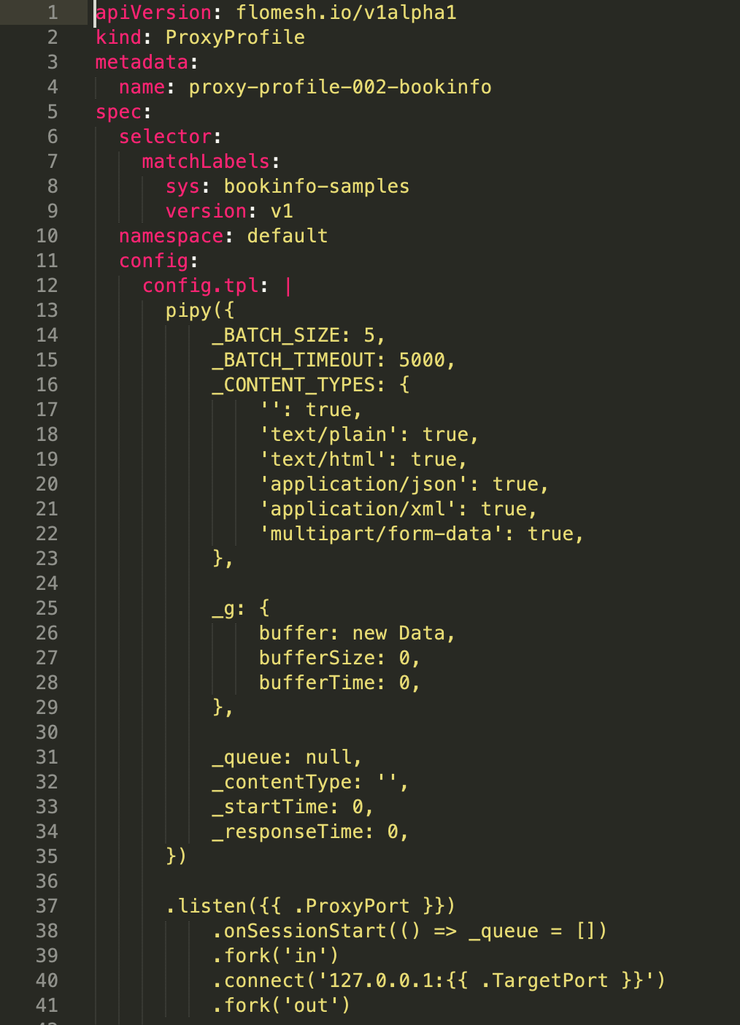
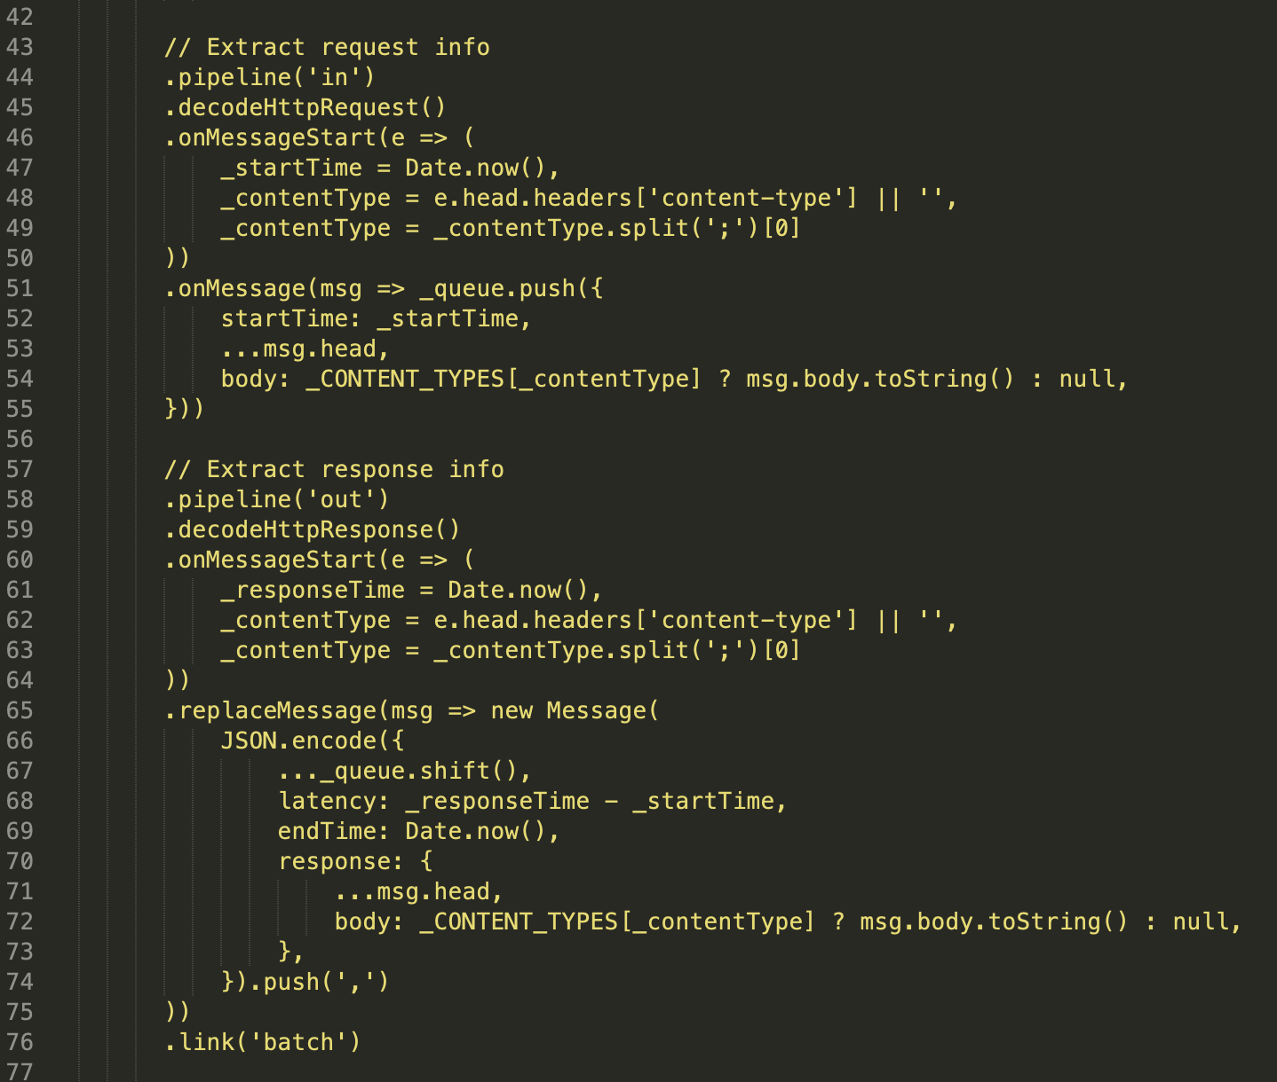
Sidecar configuration

Slide 19
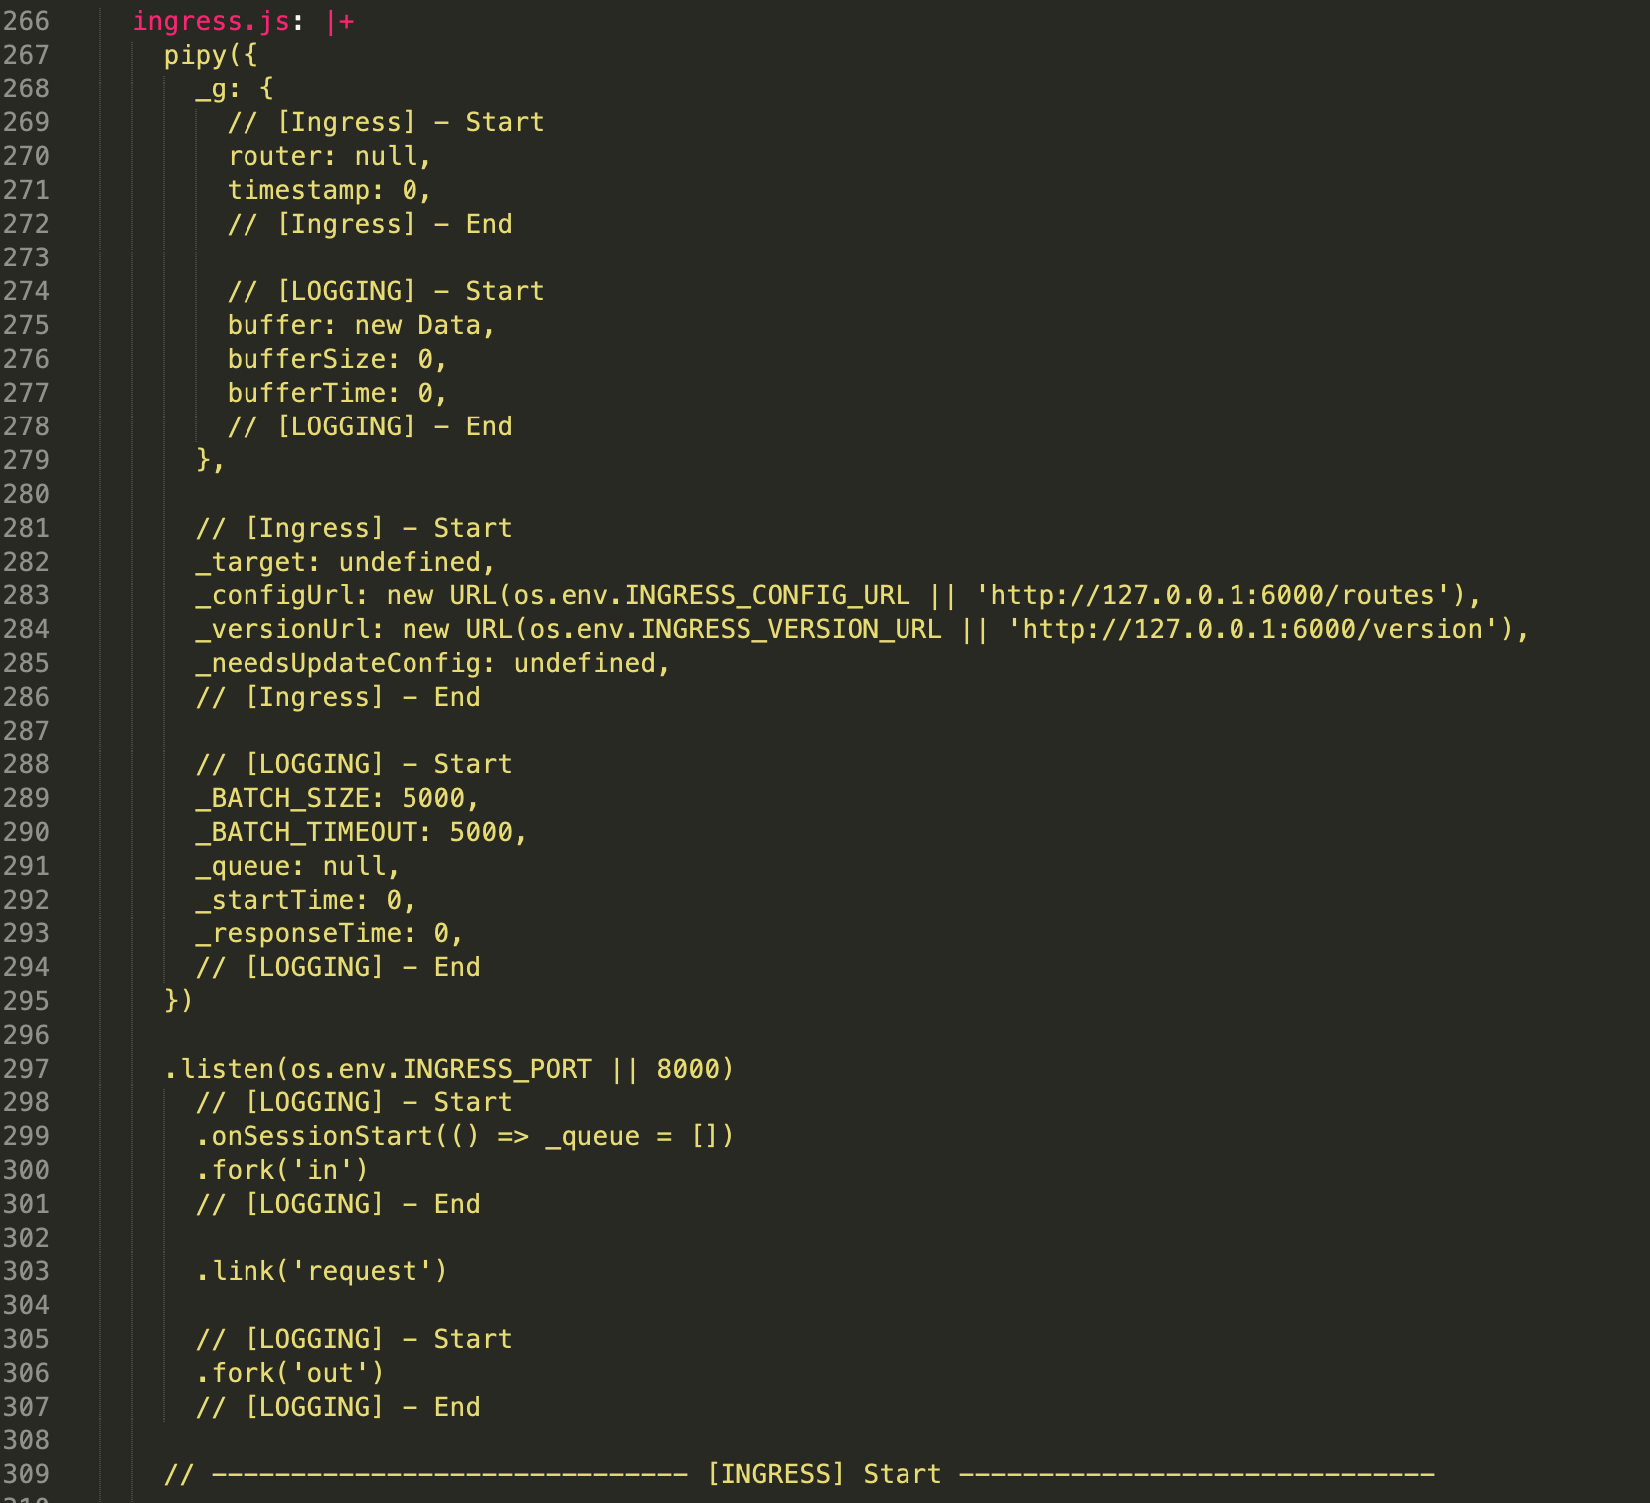
Ingress configuration

Slide 20
Check out source code
git clone https://github.com/flomesh-io/training-materials.git

Slide 21
Edit clickhouse.yaml
apiVersion: v1
kind: Endpoints
metadata:
name: samples-clickhouse
labels:
app: clickhouse
service: clickhouse
subsets:
- addresses:
- ip: 172.19.182.213
ports:
- name: chdb
port: 8123
protocol: TCP

Slide 22
Test Rating service
curl -X POST http://10.0.2.15/bookinfo-ratings/ratings \
-H "Content-Type: application/json" \
-d '{"reviewerId":"9bc908be-0717-4eab-bb51-ea14f669ef20","productId":"a071c269-369c-4f79-be03-6a41f27d6b5f","rating":3}'
curl http://10.0.2.15/bookinfo-ratings/ratings/a071c269-369c-4f79-be03-6a41f27d6b5f

Slide 23
Test Review service
curl -X POST http://10.0.2.15/bookinfo-reviews/reviews \
-H "Content-Type: application/json" \
-d '{"reviewerId":"9bc908be-0717-4eab-bb51-ea14f669ef20","productId":"a071c269-369c-4f79-be03-6a41f27d6b5f","review":"This was OK.","rating":3}'
curl http://10.0.2.15/bookinfo-reviews/reviews/a071c269-369c-4f79-be03-6a41f27d6b5f

Slide 24
Test Detail service
curl http://10.0.2.15/bookinfo-details/details/1234567890

Slide 25
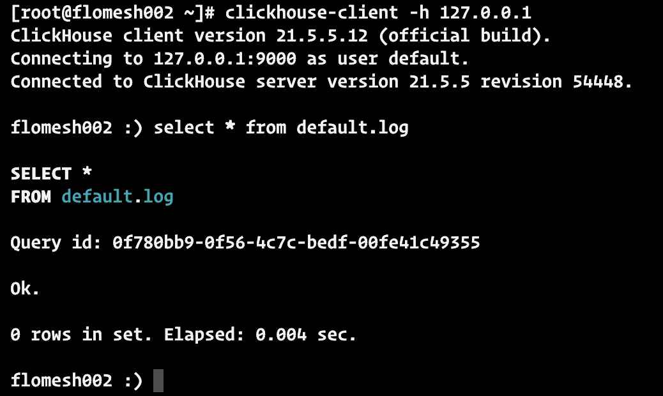
Check logs

Slide 26
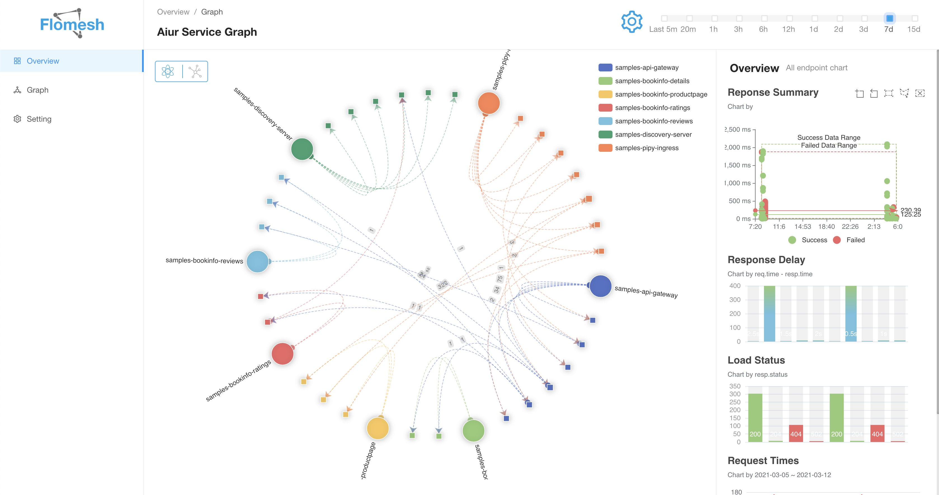
Visualize and analysis

Slide 27
The End
Any questions?

Slide 28
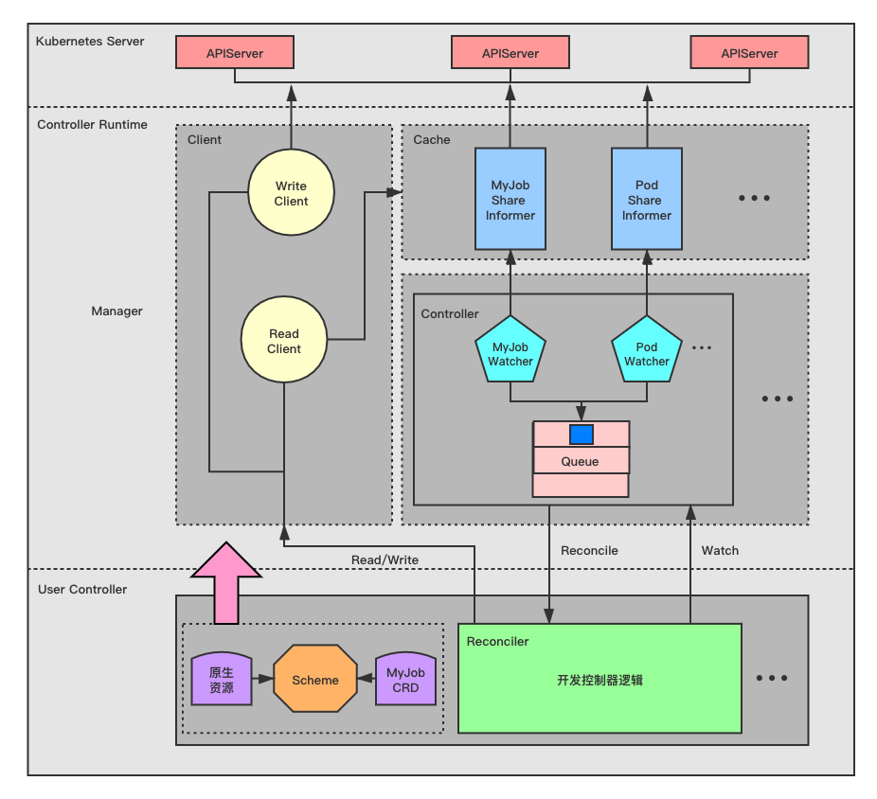
Workflow of custom controller by controller-runtime

